Slide 1



2022-23 - Annual Joint Health and Safety Committee (JHSC) Training – Part 1
October 25 & Nov 3, 2022
Presenters: Daniel Marcoux, Erica Schmidt
Location: SBO
The Workers Compensation Act (Act) section 41(1) provides the legal requirement for members of joint health and safety committees to have a total of 8 hours of educational leave. This training session covers 4 hours of the educational leave requirement.
NOTE: The Occupational Health and Safety Regulation (OHSR) section 3.27(2) provides the legal requirement for new JHSC members to receive at least 8 hours of instruction and training. This training is in addition to the training required under the Act s. 41(1). This training will be provided at a different time.
Dream. Believe. Achieve.

Slide 2
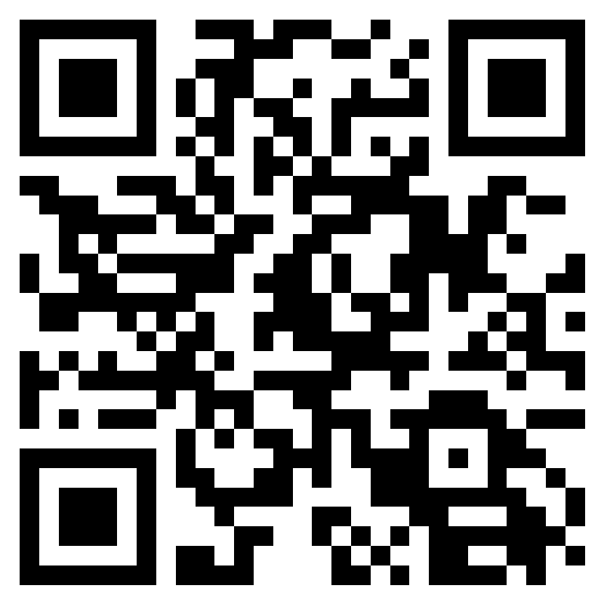
Agenda
8:00 – 8:15 Coffee and muffins – Pre-session knowledge assessment
8:15 – 8:35 – Group introductions; WorkSafeBC overview, Law 101 & short exercise, the importance of being a JHSC member
8:35 – 9:00 Hazard Identification and Risk
9:00 – 9:15 Workplace Inspections
9:15 – 9:30 Refusal of Unsafe Work exercise
9:30 – 9:45 Break
9:45 – 10:00 Load buses and drive to Hillview, VSS and Silver Star
10:00 – 10:45 School inspection
10:45 – 11:00 Load buses back to SBO
11:00 – 11:30 Debrief and Q & A – Post-session knowledge assessment
11:30 Lunch
Please complete the pre-session knowledge assessment. Just scan the QR Code
Dream. Believe. Achieve.

Slide 3
Learning Outcomes
Know the 3 basic rights of workers
Know where to find safety laws
Understand the difference between a hazard and risk
Know how to identify a hazard
Know how to conduct a workplace inspection
Understand how the hierarchy of controls is used to reduce risk of injury
Understand the Right to Refuse process
Dream. Believe. Achieve.

Slide 4
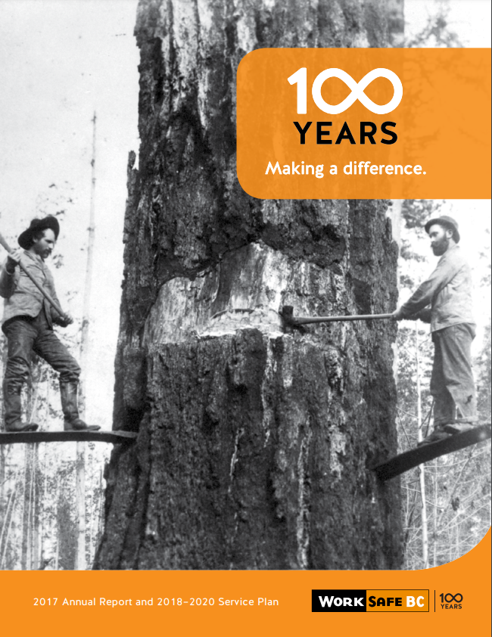
The Workers Compensation Board of British Columbia, operating as WorkSafeBC
Brief background on the Historical Compromise of 1917
Historic Compromise
Before 1917 the only option for an injured worker to get paid for lost wages and pay medical bills was to sue their employer.
Dream. Believe. Achieve.

Slide 5

Workers’ Basic Rights
Right to Know about Hazards and how to control the hazards.
Right to participate in inspections, investigations and safety meetings.
Right to refuse unsafe work.
Dream. Believe. Achieve.

Slide 6


Compliance
Law 101 – Acts, Regulations, Policies, Guidelines, Standards
Various type of Legislation (aka Acts) and subordinate Regulations
School Act [RSBC 1996] Chapter 412
section 1(1) – provides legal definition of a “teacher”
s. 2(1) Subject to section 74.1, a person is entitled to enrol in an educational program provided by the board of a school district if the person
(a) is of school age, and
(b) is resident in that school district.
Workers Compensation Act [RSBC] Chapter 1
section 1(1) – provides legal definitions for an “employer” and “worker”
s. 31 An employer must establish and maintain a joint health and safety committee
in each workplace where 20 or more workers of the employers are regularly employed
Occupational Health and Safety Regulation (OHSR)
s. 3.23 Young or new worker orientation and training
s. 3.26 Evaluation of joint committee
School Regulation
s. 4 Duties of teachers
s. 5 Powers and duties of principals, vice principals or director of instruction
Employers MUST post a Notice to Workers on how to find a copy of the Act and Regulations. JHSC members must know how to find the safety laws
https://www.worksafebc.com/en
Dream. Believe. Achieve.

Slide 7
Group Exercise- Find a friend with a device
QUESTION: A JHSC member wants to know if a SAFETY COURSE on DOG GROOMING can be used as part of the 8 hours of training?
Go to the WorkSafeBC website and find the answers to these 2 questions.
a) “How are decisions as to when members will attend courses, what courses they will attend, and what time?” (Where is the answer found? Act, Regulation, Policy, Guideline or Standard)
Answer: Policy Item P2-41-1
2. “What courses are considered APPROVED to meet the educational leave requirements?” (Where is the answer found? Act, Regulation, Policy, Guideline or Standard)
Answer: Guideline G-P2-41-1 JHSC Courses
Dream. Believe. Achieve.

Slide 8
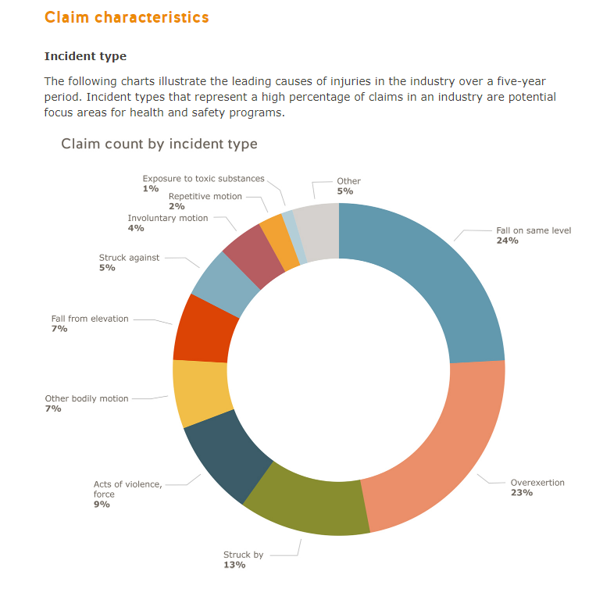
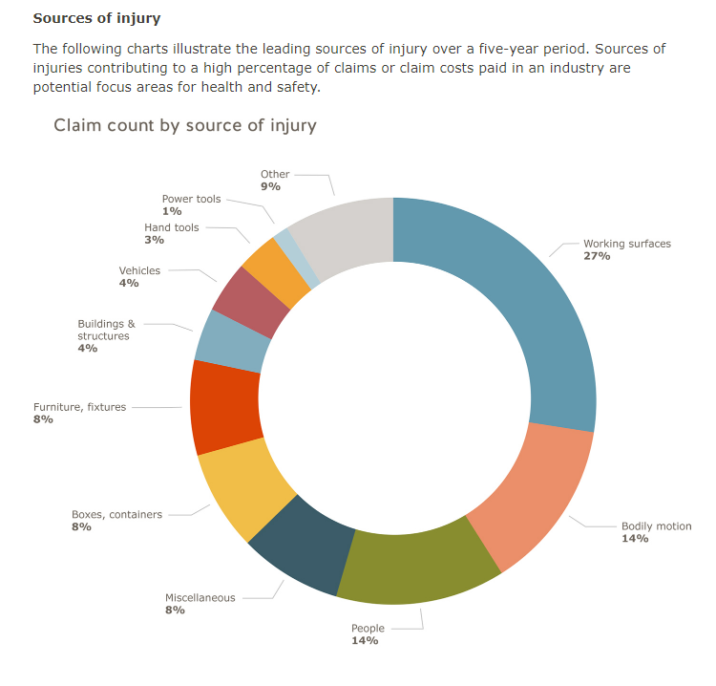
Education sector – Claim Data
Dream. Believe. Achieve.

Slide 9
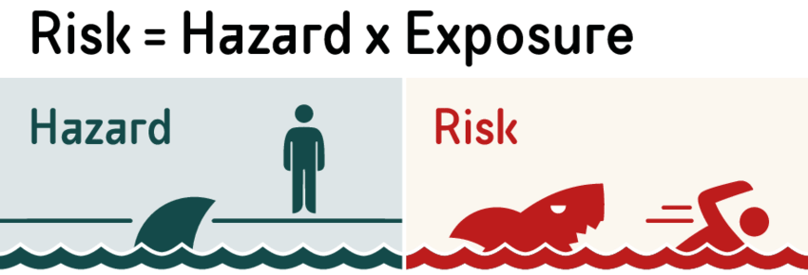
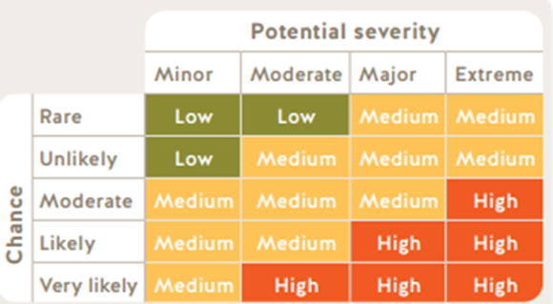
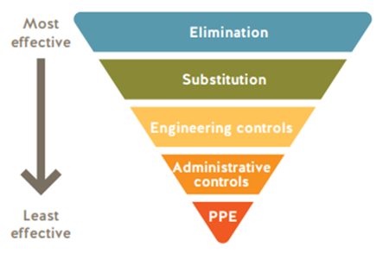
Hazard & Risk
What is the difference between Hazard & Risk?
How can hazards be control to minimize the risk of injury to a worker?
"hazard" means a thing or condition that may expose a person to a risk of injury or occupational disease;
"risk" means a chance of injury or occupational disease
Dream. Believe. Achieve.

Slide 10
Group Exercise – Find a friend with a device
Let’s play – Spot the Hazard
Hazards can be broadly identified as:
Chemical
Biological
Physical (General, MSI, Mechanical, Slips & trips)
Energy (Electrical, Magnetic, Noise, Thermal, Vibration)
Explosion
Only do the Landscape and Kitchen Challenges
https://spotthehazardsworksafebc.com/
Dream. Believe. Achieve.

Slide 11
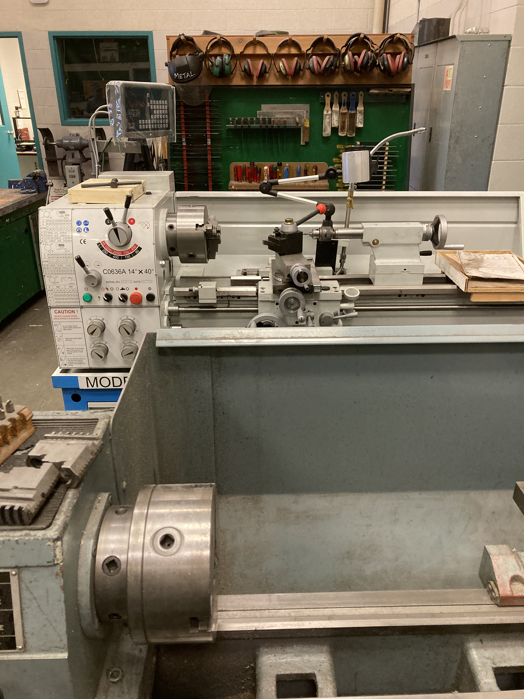
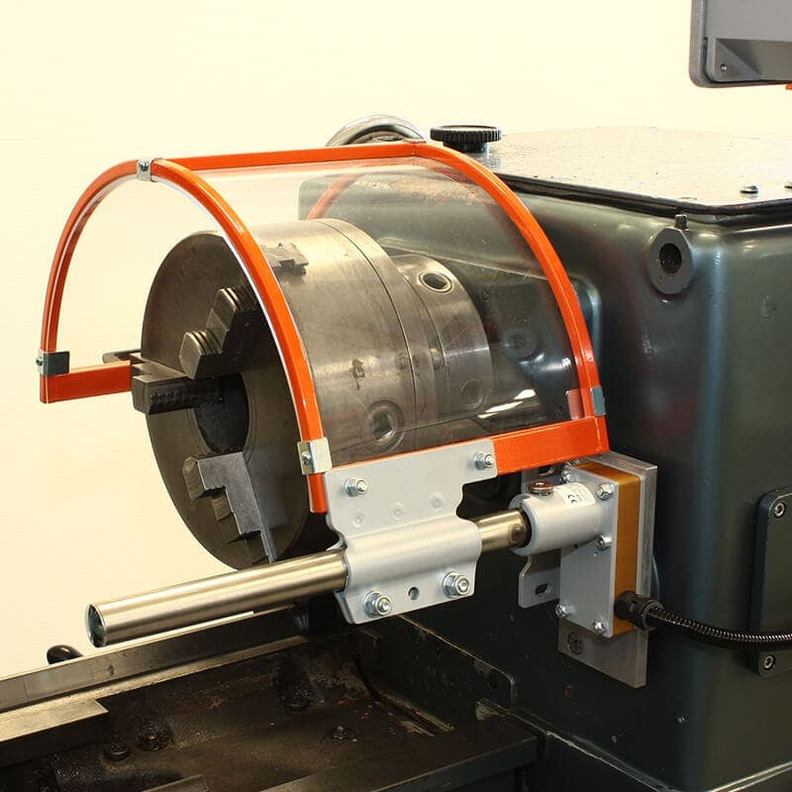
Workplace Inspections
OHSR s. 3.5 General requirement
Every employer must ensure that regular inspections are made of all workplaces, including buildings, structures, grounds, excavations, tools, equipment, machinery and work methods and practices, at intervals that will prevent the development of unsafe working conditions.
WorkSafeBC Workplace Inspection webpage
OHSR s. 12.38 Lathe chucks
Dogs that extend beyond the circumference of a lathe chuck must be safeguarded from contact by the operator.
WorkSafeBC Safety Inspection Workbook
Dream. Believe. Achieve.

Slide 12
SD22 – Joint Health and Safety Committee Training
SD22 Leadership Meeting
September 15, 2022
Charles Bloom Secondary School
Presenters: Erica Schmidt & Daniel Marcoux
Dream. Believe. Achieve.

Slide 13


What has changed?
OHSR s. 3.12.1 – Reassignment of refused work
Why changed is required?
Regulatory amendment: A primer on refusing unsafe work
What do I need to do?
Review the Guide and complete the form
SD22 Safety Website
Dream. Believe. Achieve.

Slide 14
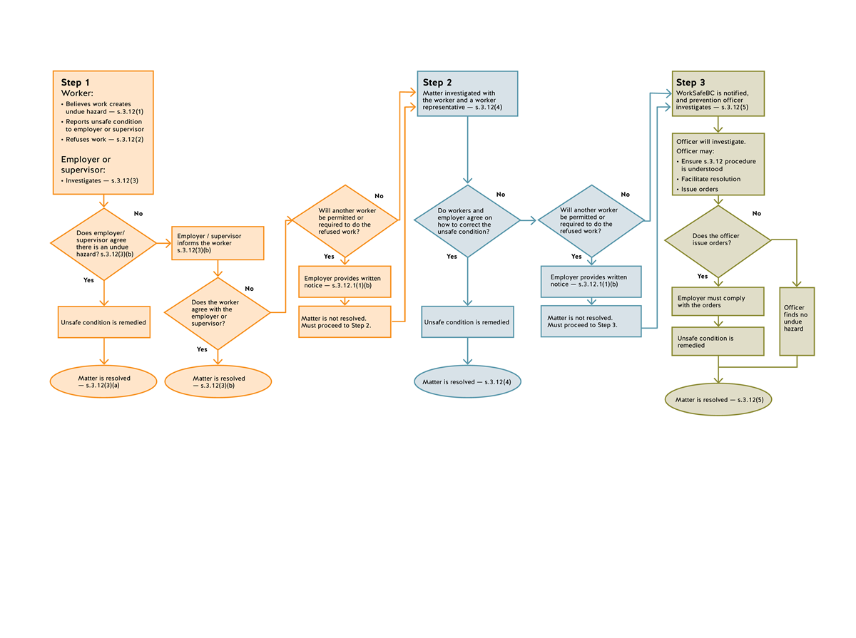
Guideline G3.12 Refusal of Unsafe Work - Flowchart
Let’s practice – Get into groups of 3
Dream. Believe. Achieve.

Slide 15
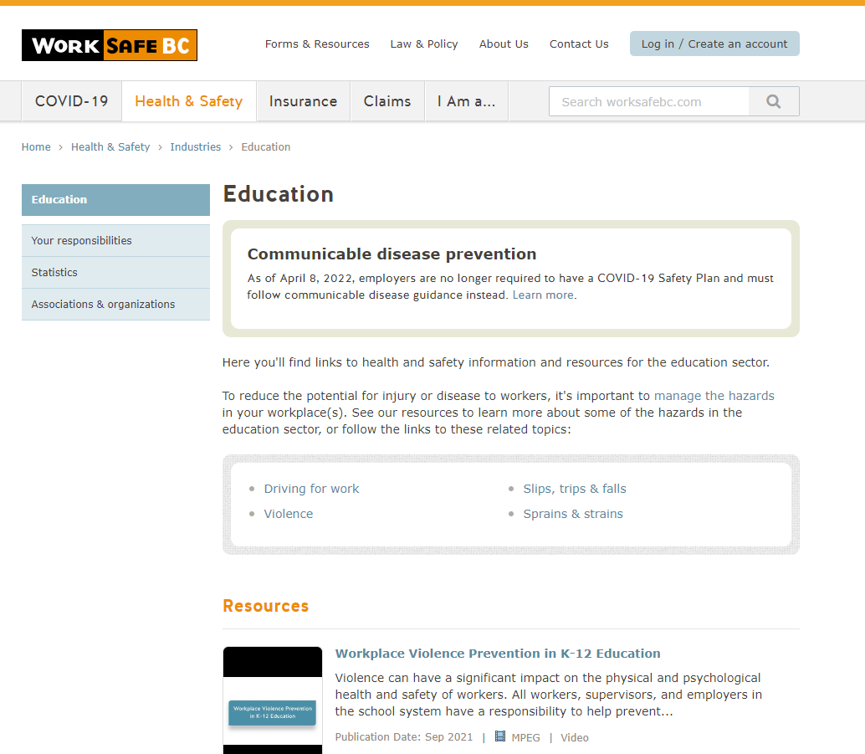
External Resource
WorkSafeBC Education Page
Dream. Believe. Achieve.

Slide 16


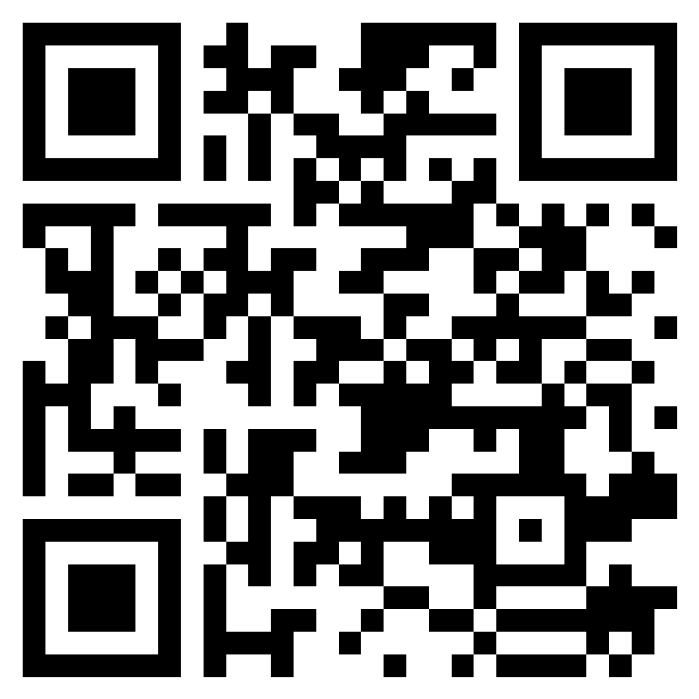



Thank you for your:
attention,
kindness, and
dedication.
Friendly Reminder:
When completing JHSC Meeting Minutes, workers’ name and gender can’t be included due to medical privacy requirements.
Please complete the Post-Session Knowledge Assessment. Just scan the QR Code
Any questions ?
Safety Questions can be emailed to
safety@sd22.bc.ca

